Slide 1

EXIM 101
Export Finance Solutions

Slide 2
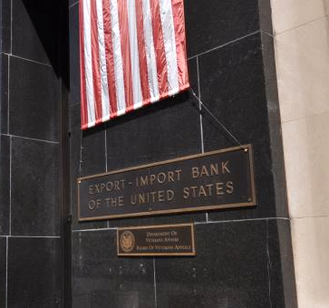

WHO WE ARE – WHAT WE DO
EXIM Bank is a U.S. federal government agency
Mission: Maintain and create U.S. jobs by supporting the growth of U.S. exports
Established in 1934
Headquartered in Washington, D.C.
12 Regional Offices nationwide
Support for all U.S.-based companies who export

Slide 3
OUR FINANCING SUPPORT MAKES THE DIFFERENCE
Minimize risk
Level the
playing field
Supplement commercial financing

Slide 4
WORKING CAPITAL GUARANTEE (WCG)
Assists small and mid-size companies in obtaining working capital to produce or purchase U.S. goods and services for export
Provides a 90% guarantee of repayment on loans to exporters
May be set up as “Transaction-Specific” or a “Revolving” Line of Credit
Loan proceeds may also be used to collateralize a stand-by letter of credit to be used as a performance bond (25% collateralization)
No minimum or maximum amounts
Support advances against export-related inventory (including WIP) foreign receivables
  Up to 75% advance rate on inventory, and up to 90% on foreign receivables

Slide 5
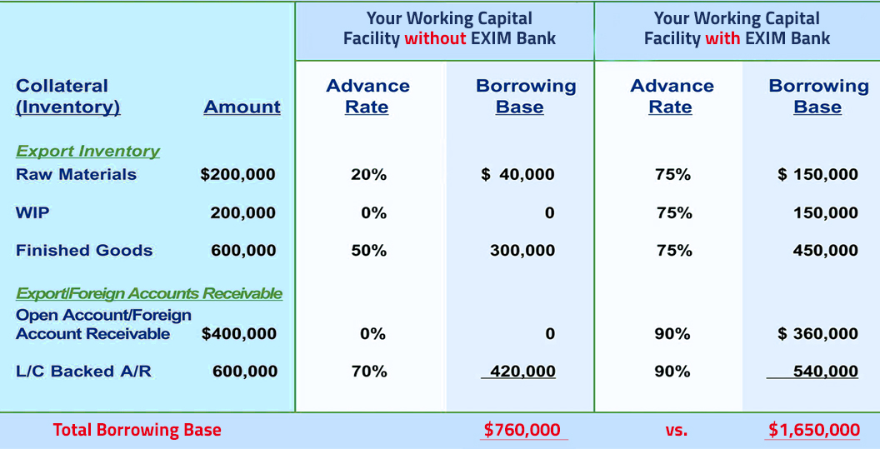
WORKING CAPITAL GUARANTEE (WCG)
Collateral (Inventory)
Amount
Collateral (Inventory)
Export Inventory
Raw Materials
$200,000
WIP
$200,000
Finished Goods
$600,000
Export Inventory
Raw Materials
$200,000
WIP
$200,000
Finished Goods
$600,000

Slide 6

SALES TERMS AS A SPECTRUM OF RISK
Seller Risk Low
Buyer Risk High
Sale Terms
Cash in Advance
Letter of Credit (L/C)
Cash Against Documents
Open Account
Seller Risk High
Buyer Risk Low

Slide 7
EXPORT CREDIT INSURANCE – BENEFITS
Risk Prevention:
Protect against nonpayment by foreign buyers
due to:
Sales Tool:
Allows exporters to offer competitive credit terms to foreign buyers
Financing Aid:
Obtain additional financing
  Insured foreign receivables may be added to your borrowing base by assignment of policy proceeds (claim payments) to a lender
  Commercial risks
  Political risks
  Generally up to 180 days
  Some products may qualify for 360 day terms

Slide 8
RISKS COVERED
Commercial Risk:
Insolvency
Bankruptcy
Cancellation of an Import or Export License
Protracted Default
Political Risk:
War, Revolution, Insurrection
Currency Transfer Risk

Slide 9
SMALL BUSINESS EXPRESS INSURANCE: KEY FEATURES
95% coverage for nonpayment due to commercial insolvency/bankruptcy/default) and political (war, revolution, “transfer risk”) risks
Insuring existing buyers is optional
No deductible! No application fee!
EXIM pre-approves all credit limits requested and obtains credit information on your buyers at no additional cost to you
5 business day buyer approval turnaround on credit limits of $500,000 or less (longer turnaround on higher amounts)
No minimum sales volume or premium … pay only on the gross invoice value of what you ship, when you ship!

Slide 10

SMALL BUSINESS EXPRESS INSURANCE: RATES
Rates are charged according to the length of the credit term you extend and the buyer type
  For a sale to a private sector buyer on terms up to
  60 days open account - $0.65 per $100 of the gross invoice value.
  On a $25,000 sale, that’s only $162.50 in premium!
AND… if you use insurance with a working capital guarantee from either EXIM OR the SBA, you get
a 25% rate reduction on your premiums!

Slide 11
MEDIUM-TERM FINANCING SUPPORT
Generally used for buyer financing of capital equipment
85% financed, 15% cash down payment by the buyer (may be financed by a lender)
Repayment up to 5 years, exceptionally 7 years
Amounts of $25 million or less
Financing can be accomplished through the following EXIM products:
  Lender guarantees
  Credit Insurance
  Direct Loans (few)

Slide 12
JUST A FEW RESTRICTIONS
No Military or Defense-related products or obligors
(exceptions apply)
U.S. Content (Short-Term: 50+%; Medium-Term: 85% U.S.)
Restricted Countries (Country Schedule)
Economic impact
Shipping
Additionality

Slide 13

COUNTRY LIST
EXIM conducts business in many countries throughout the world
Restrictions or special conditions may apply for political or economic conditions
Check the Country Limitation Schedule (CLS) at www.exim.gov

Slide 14
CONTACT A REGIONAL OFFICE NEAR YOU
Eastern
Miami: 305-526-7436
New York: 212-809-2650
Atlanta: 404-815-1497
Chicago: 312-353-8093
Houston: 281-721-0470
Minneapolis: 612-348-1213
Dallas: 214-551-4959
Detroit: 313-226-3067
Orange County: 949-660-1341
San Diego: 858-467-7035
Seattle: 206-728-2264
Central
Western

Slide 15
Questions?

Slide 16
Regina Gordin
Deputy Managing Director, Eastern Region
(917) 826-5642
Regina.Gordin@exim.gov

